Slide 1
Champions of
Brand Management:
How to Remove Negative Reviews and Best Practices for Review Responses
IFA WEBINAR SERIES
March 8, 2022
SPONSORED BY:

Slide 2
Webinar Sponsor
Mark Spencer, COO
(858) 201-4732
mark@consumerfusion.com
www.consumerfusion.com

Slide 3
Speakers
Brynn Gibbs
Founder & CEO
brynn@consumerfusion.com
(800) 381-9987
Mark Spencer
COO
mark@consumerfusion.com
(858) 201-4732

Slide 4
Overview
How to Identify Negative Reviews
How to Dispute Negative Reviews
Why You Need to Respond to Online Reviews
Examples of Good & Bad Responses

Slide 5
80% of consumers say a negative review has deterred them from visiting a business.
Source: 2021 Consumer Fusion Survey; How Negative Reviews Alter Potential Consumers

Slide 6
55% of consumers are more likely to read a business’ negative reviews first.
Source: 2021 Consumer Fusion Survey; How Negative Reviews Alter Potential Consumers

Slide 7
Negative Content & How it Affects your Brand
It’s not a myth, negative reviews and photos can be removed from major review sites like Google, Yelp, Facebook, Glassdoor & Indeed.
Reviews that violate the terms and conditions of the review site can be disputed and removed from the internet.
This also applies to Photos, Yelp Tips, and Google Questions.
Negative reviews don’t only affect potential sales from customers but also franchise sales.

Slide 8
Identifying Illegitimate Reviews
While every individual directory may differ in terms of what’s considered inappropriate, the majority of reviews that contain the following content have a high rate of removal:
Spam or promotional material
Personal rant from a former employee
Not a direct first hand experience
Reviews for the wrong location
Covid Rants
Labor Shortage

Slide 9
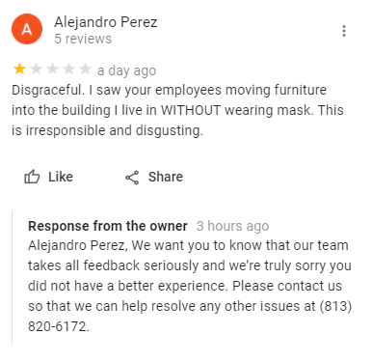
Examples of Illegitimate Reviews

Slide 10
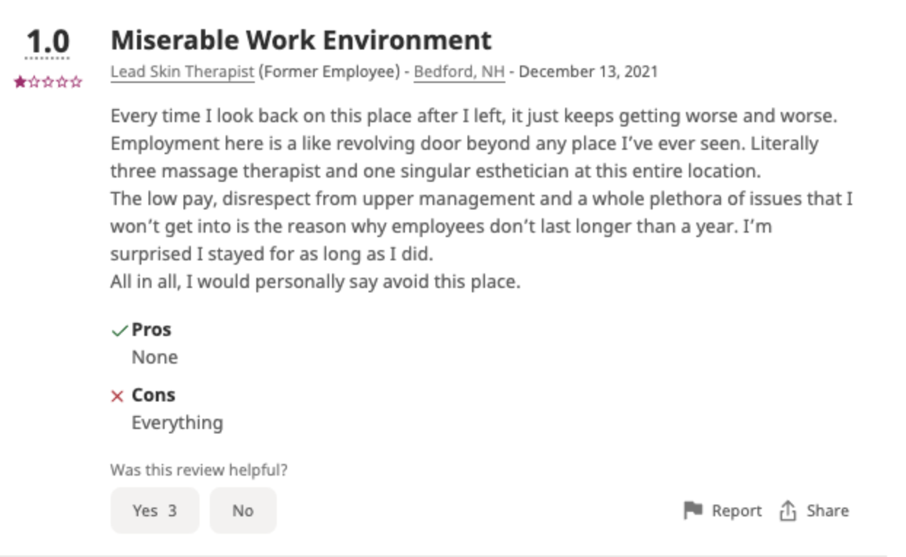
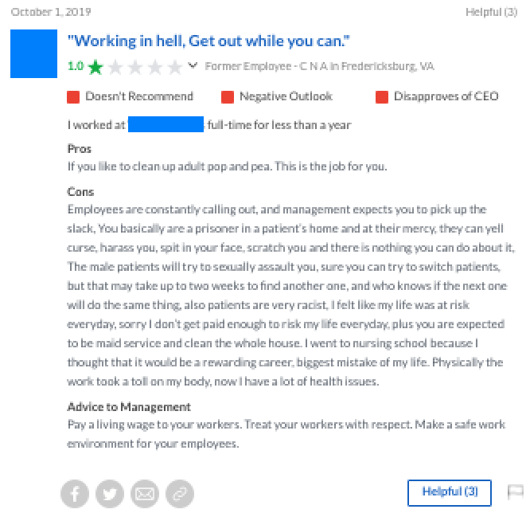
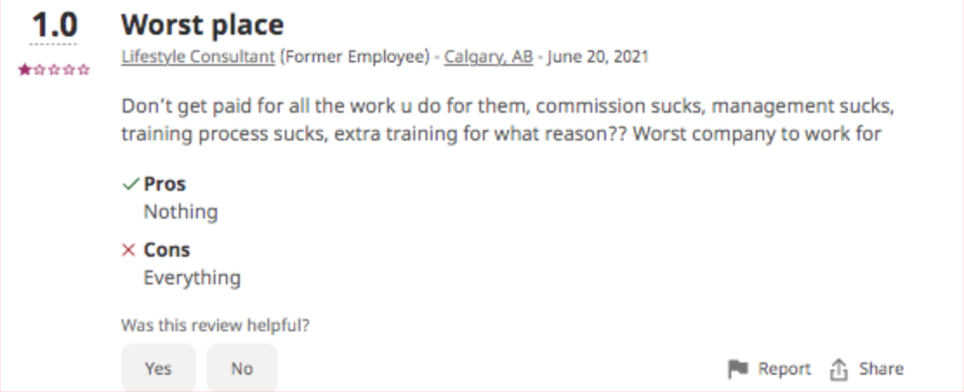

Slide 11
How to Dispute Negative Reviews

Slide 12
Flagging and Disputing Negative Reviews
When disputing negative reviews it’s important to stick to the facts and the content of the review and how it violates the terms & conditions.
Don’t get emotional in your dispute response.

Slide 13
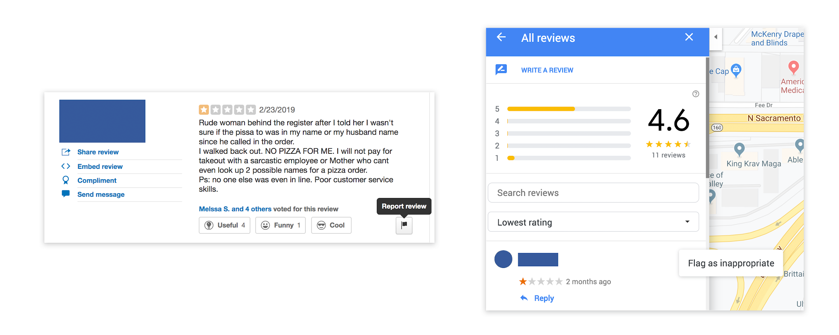
Flagging and Disputing Negative Reviews
Take action and report the review to that specific site’s content moderators by flagging the review.

Slide 14
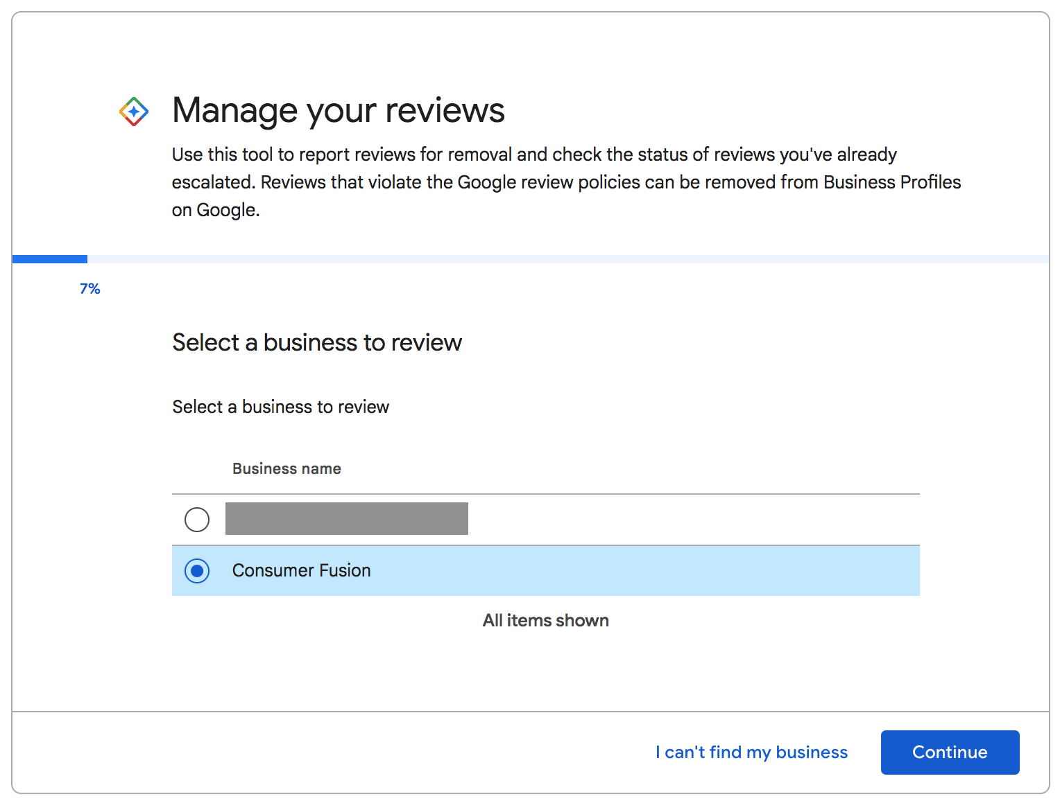
If your GMB account includes a small number of locations you can use Google’s Review Management Tool: https://support.google.com/business/workflow/9945796

Slide 15
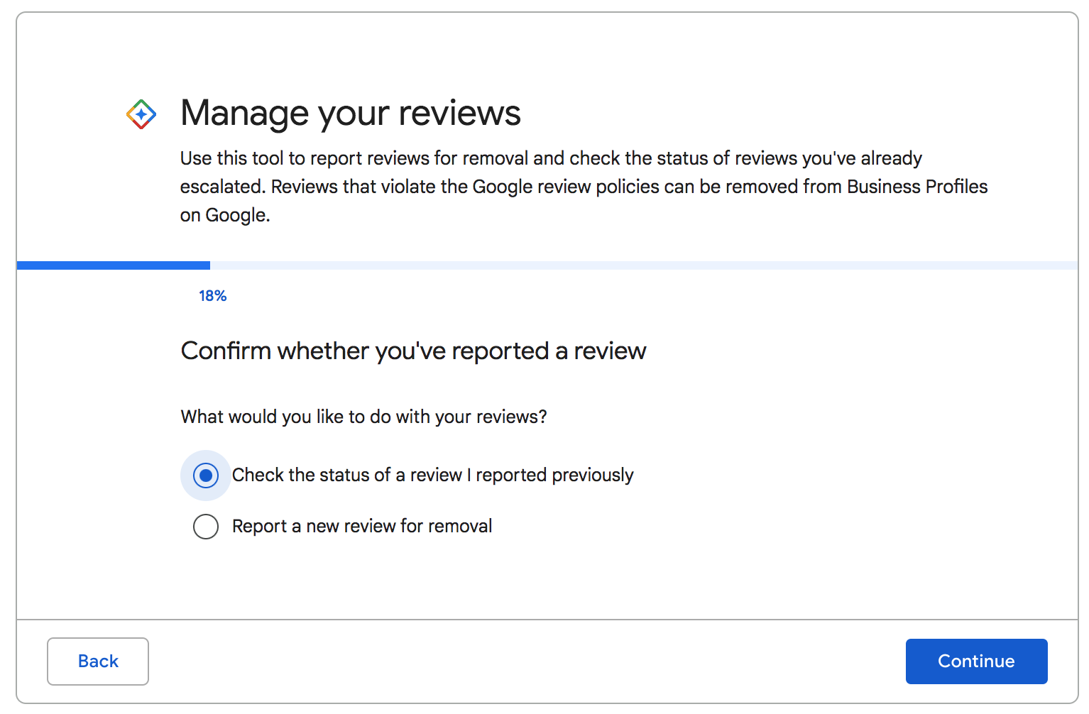
If your GMB account includes a small number of locations you can use Google’s Review Management Tool: https://support.google.com/business/workflow/9945796

Slide 16
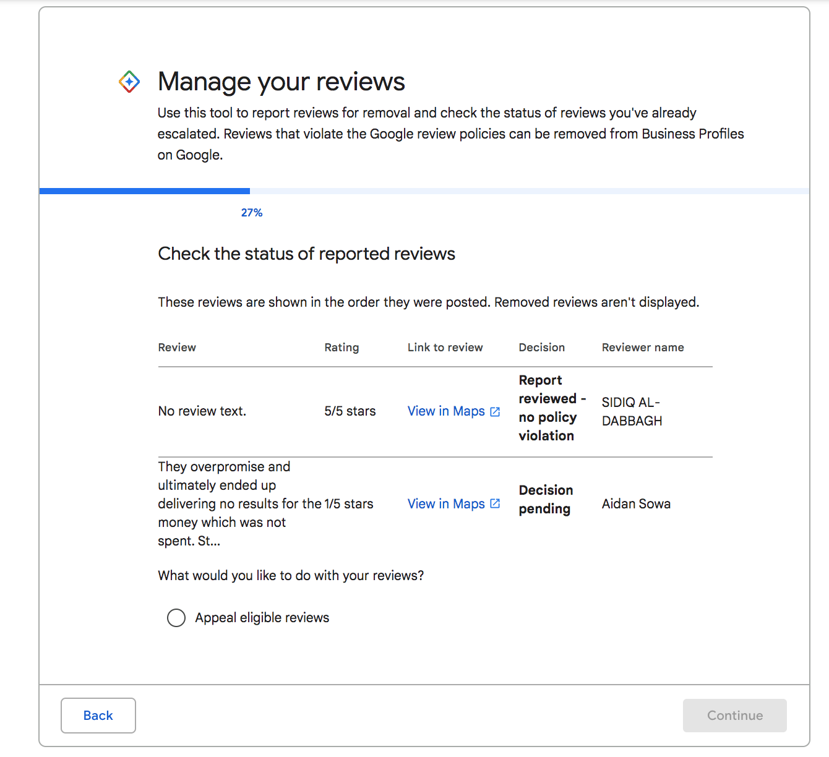
If your GMB account includes a small number of locations you can use Google’s Review Management Tool: https://support.google.com/business/workflow/9945796

Slide 17
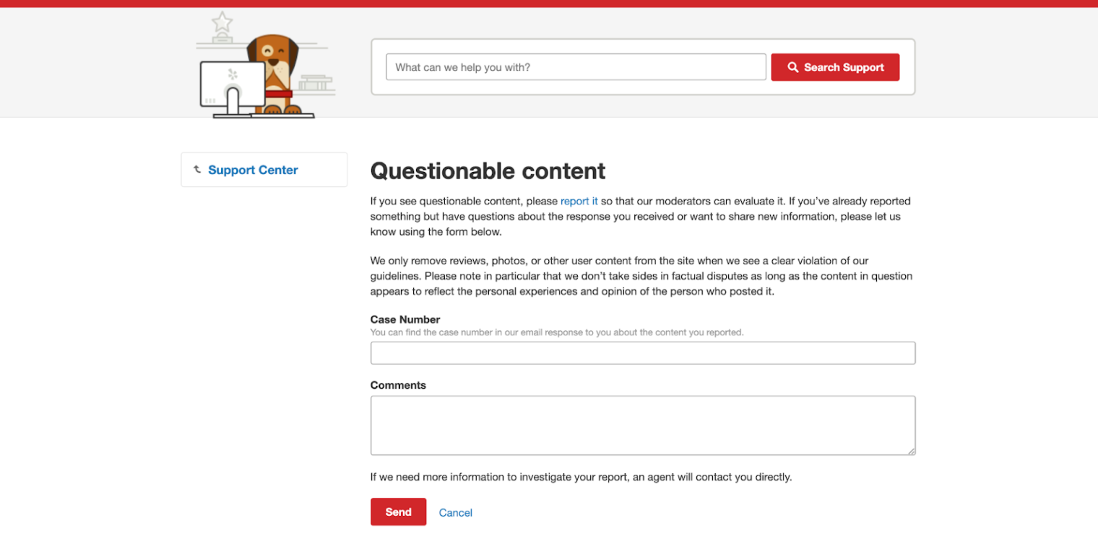
Visit: https://www.yelp.com/support/contact/flagged_content?src_article_id=000005274

Slide 18
Following Up on Disputed Reviews
Check your online listing regularly for any changes to your overall rating.
Most review sites will also send an email to notify you, whether the review was successfully removed or your request for removal was denied.
On Google, you can dispute the same review more than once.

Slide 19
Responding to Your Online Reviews

Slide 20
90% of consumers read business owner’s responses to negative reviews.
Source: 2021 Consumer Fusion Survey; How Negative Reviews Alter Potential Consumers

Slide 21
According to Yelp’s Data Science team, reviewers are 33% more likely to upgrade their review if you respond to a review within a day.
Source: https://blog.yelp.com/2017/03/responding-reviews-within-24-hours-boosts-upgrade-probability

Slide 22
Responding to Online Reviews
Best Practices for review responses:
Respond to all of your reviews, both positive and negative.
Respond within 24 - 48 hours of a new review.
Include keywords and categories to boost your Local SEO.
To respond to a positive review, all it takes is a sentence or two to express your gratitude.
Responding to negative reviews requires a more careful approach.

Slide 23
Responding to Online Reviews
Best Practices for Responding to Negative Reviews:
Express that you are empathetic without directly admitting fault.
Find a way to take the conversation offline by offering to reach out to the unhappy customer privately. It’s possible to work with the customer to get them to update or remove their review
Include a contact email or phone number in the response
Privately message the customer (only available via Yelp)
Be aware that customers pay attention to the way businesses handle their responses.

Slide 24
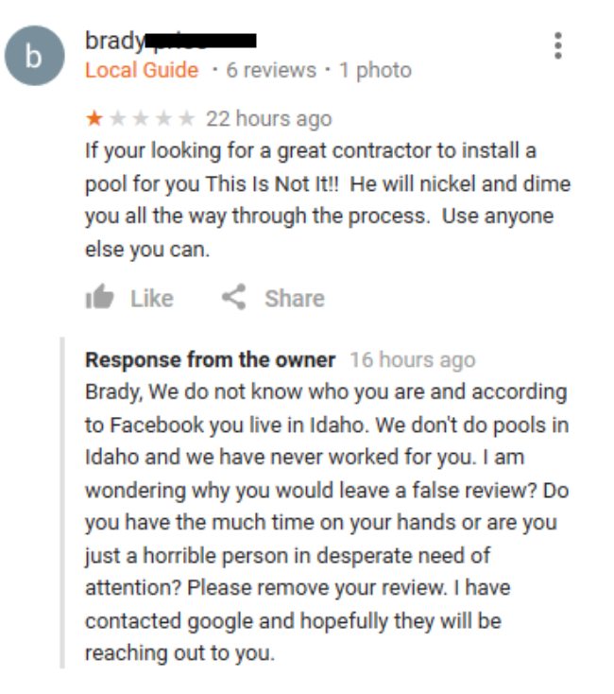
Responding to Online Reviews
What Not to Do

Slide 25
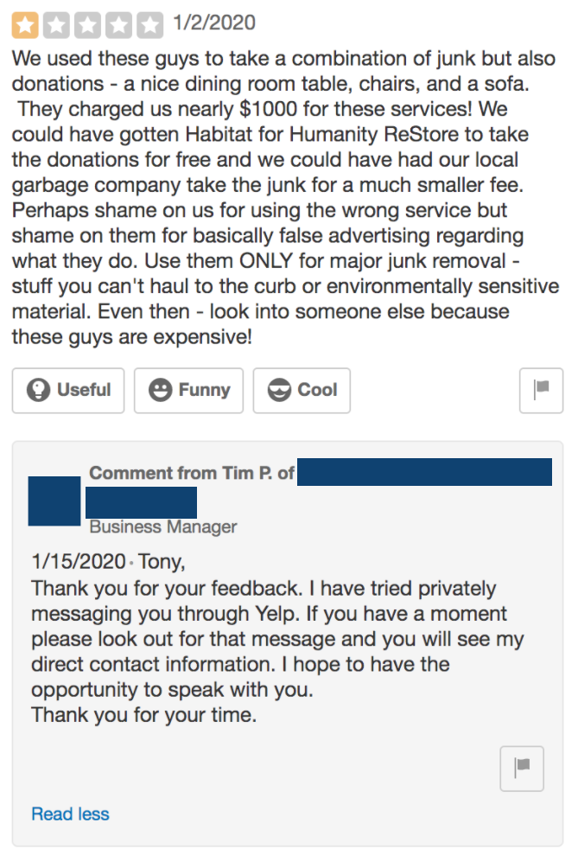
Responding to Online Reviews
What You Should Do

Slide 26
Responding to Online Reviews
Don’t neglect employee review sites like Glassdoor and Indeed.
Potential new employees are looking you up online and addressing false negative content can improve your star rating on these sites.
It’s important to prioritize the reviews on your corporate location pages. They can typically become a sounding board for bad experiences but in many cases these reviews violate the terms & conditions and can be removed.

Slide 27
Key Takeaways
Negative reviews that violate terms & conditions can be disputed and removed from review sites.
It’s important to leave an owner’s response on your negative reviews along with your positive reviews.
Customers are paying attention to how you respond to your online reviews.
Negative reviews don’t only affect a loss of business from new customers but could also affect new hires and new franchise sales as well.

Slide 28
Questions?

Slide 29
Thank you for attending!

