Slide 2
New Member & First Time Attendee Pre-Convention Webinar
We’re excited to have you at the 2024 IFA Annual Convention!

Slide 3
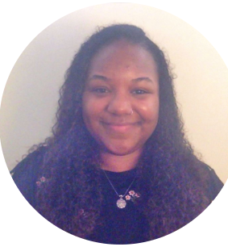
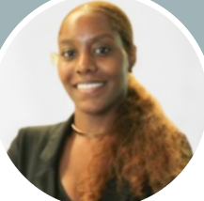
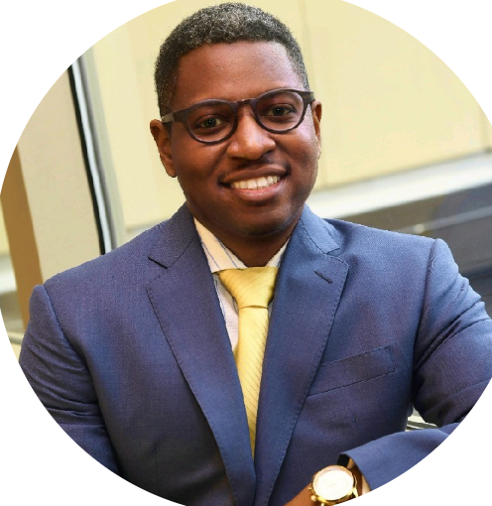
Introductions
Brittney Cosby
Senior Manager, Certification Programs
bcosby@franchise.org
Sydni Konohia
Manager, Member Services & Retention
skonohia@franchise.org
David Smith
Director, Diversity Programs
dsmith@franchise.org

Slide 4
General Convention Overview
What does the registration fee include?
Exhibit Hall access
Food & Beverage served in Exhibit Hall and at receptions
Education Sessions, Workshops and Roundtables
General Sessions
Opening & Closing Receptions
On-site community service project
IFA Unplugged
Pre and post event registration lists

Slide 5
General Convention Overview
Where is Convention taking place?
Primary Event Location
Phoenix Convention Center
Secondary Event Location/Host Hotel
Sheraton Phoenix Downtown Hotel
Additional Hotels
As of January 22, all IFA room blocks are sold out! For additional hotel information, please visit www.franchise.org/convention

Slide 6
“Wear Your Brand” Day
Every year at Convention, IFA loves to highlight the amazing brands that our sponsors, exhibitors and attendees represent!
Come dressed in your companies branded apparel on Saturday, February 17th!

Slide 7
General Convention Overview
What are the additional special sessions and are they mandatory?
Friday, February 16th and Saturday, February 17th
CFE Special Sessions
Saturday, February 17th 11:45 AM – 4:00 PM MT
Annual Leadership Conference: $239 standard/$339 onsite
Saturday, February 17th 7:30 AM – 10:30 AM MT
Emerging Franchisor Bootcamp: $149
These sessions are not mandatory, but they’re excellent networking and professional development opportunities!

Slide 8
Pre-Convention Special Sessions & CFE Credits
The Certified Franchise Executive (CFE) designation is a symbol of leadership and accomplishment recognized throughout the franchise community!
Attendance at the 2024 IFA Annual Convention will offer 13 Participation Credits.
To receive additional credits, you can sign up for a CFE Special Session on February 16th and/or 17th and earn up to 14 CFE Education Credits & 8 CFE Core Credits
*CFE participation is not a pre-requisite for attending the Special Sessions
For additional CFE information, please email cfe@franchise.org or visit www.franchise.org/cfe

Slide 9
Pre-Convention Special Sessions & CFE Credits
Friday, February 16th 9 AM – 5 PM MT
IFA Fran-Guard™ - Mandatory Course for All CFE Candidates – 8 CFE Core Credits
Discovering Your Authentic Leadership Style: How You are Wired to Lead and Succeed – 7 CFE Education Credits
Principles of Franchising – 7 CFE Education Credits
Profit Mastery: Financial Boot Camp Part 1 – 7 CFE Education Credits
Friday, February 16th 9 AM – 12:30 PM MT
Franchise Marketing Today! – 3.5 CFE Education Credits
How to Get Franchisee Buy-In to New Initiatives – 3.5 CFE Education Credits
Friday, February 16th 1:30 PM – 5 PM MT
Cracking the Code to Customer Devotion – 3.5 CFE Education Credits
Inclusive Leadership for a Multi-Generational Workforce – 3.5 CFE Education Credits

Slide 10
Pre-Convention Special Sessions & CFE Credits
Saturday, February 17th 8 AM – 4 PM MT
IFA Fran-Guard™ - Mandatory Course for All CFE Candidates – 8 CFE Core Credits
Gaining an In-Depth Understanding of Franchising – 7 CFE Education Credits
The 6 Critical Practices for Leading a Team – 7 CFE Education Credits
Delivering Effective Field Support that Franchisees Value – 7 CFE Education Credits
Saturday, February 17th 8 AM – 11:30 AM MT
Franchise Recruitment Essentials – 3.5 CFE Education Credits
Leveraging Technology to Power Franchise System Growth – 3.5 CFE Education Credits
Saturday, February 17th 12:30 PM – 4 PM MT
Scaling for Growth: Multi-Unit/Multi-Brand Expansion Strategies – 3.5 CFE Education Credits
Managing Franchise Resales – 3.5 CFE Education Credits

Slide 11
Preparing for Convention
Book hotel and travel
Connect with other attendees via LinkedIn
Download the 2024 IFA Annual Convention App – going live February 9th
Review agenda
If attending with colleague’s, create a plan to divide and conquer the Breakout Sessions
Keep business cards handy
Convention attire might be business casual, but comfortable shoes are a must!
Don’t miss any important information! Ensure you’re receiving IFA emails
Important Convention details will be sent to all registrants the second week of February from ifaevents@mocandco.com

Slide 12
Convention Moments You Don’t Want to Miss!
Saturday, February 17th 3:15 PM – 4:15 PM MT
New Member & First Time Attendee Reception and Workshop – Sponsored by Benetrends & Hyperlocology
Saturday, February 17th 6:30 PM – 8:00 PM MT
Opening Reception – Sponsored by Quarles & Brady LLP
Sunday, February 18th 9:45 AM – 10:30 AM MT
New Supplier Member/First Time Supplier Attendee Meet Up – Sponsored by INFINITI HR & SFAB
Sunday, February 18th 3 PM – 4:30 PM MT & Monday, February 19th 10:30 AM – 12 PM MT
Thought Leadership Roundtables
Monday, February 19th 9:00 PM MT - MIDNIGHT
IFA Unplugged – Sponsored by Hoffer Adler & Franchise Update Media

Slide 13
Additional Convention Networking Opportunities
Committee Meeting – Friday, February 16th
Membership Committee
Committee & Forum Meetings - Saturday, February 17th
Women's Franchise Committee
Franchise Relations Committee
Supplier, Franchisor and Franchisee Forums
Legal Legislative & Legislative Action Group (LAG)
Marketing & Innovation Committee
VetFran Committee
Social Sector Committee
Committee Meeting & Other Events – Sunday, February 18th
International Committee Meeting
Sponsored Evening Events
Community Service Project
To get involved with an IFA forum or committee, please visit www.franchise.org/committees-and-forums

Slide 14
Why Visit the Exhibit Hall?
More than 240 exhibiting Supplier companies covering over 40 different verticals!
Service to Convention breakfast, lunches, and breaks
Recharging Stations
Direct access to General Sessions
Franchising Gives Back Community Service Project
Stop by IFA’s booth (723) with any questions!
Get to know the awesome 2024 IFA Annual Convention Exhibitors here!

Slide 15
Educational Tracks & Summits
Over 37 Educational Breakout Sessions
7 Super Sessions & Immersive Workshops
10 Education Tracks:
Emerging Franchisor
Finance
Franchise Development
Franchise Relations
Franchisee
Industry Trends
International
Marketing
Operations
Plan your time in Phoenix with ease by following a curated Education Track based on hot topics and trends in the industry!

Slide 16
Franchising Gives Back at Convention
Join IFA Staff and your fellow Convention Attendees in the Exhibit Hall, as we pack meals for people and families in need within the local Phoenix community!
Sunday, February 18th
12:30 pm – 1:30 pm MT
5:00 pm – 6:30 pm MT
Monday, February 19th
9:00 am – 10:30 am MT
12:30 pm – 1:30 pm MT
5:00 pm – 6:30 pm MT

Slide 17
Staying Connected During Convention
Your badge is your access to all things Convention...keep it close!
Connect with fellow attendees and post Convention highlights within the app
Participate in EVERYTHING
Strike up conversation with everyone you meet
Make sure you’re tagging IFA in your social posts and using #IFA2024

Slide 18
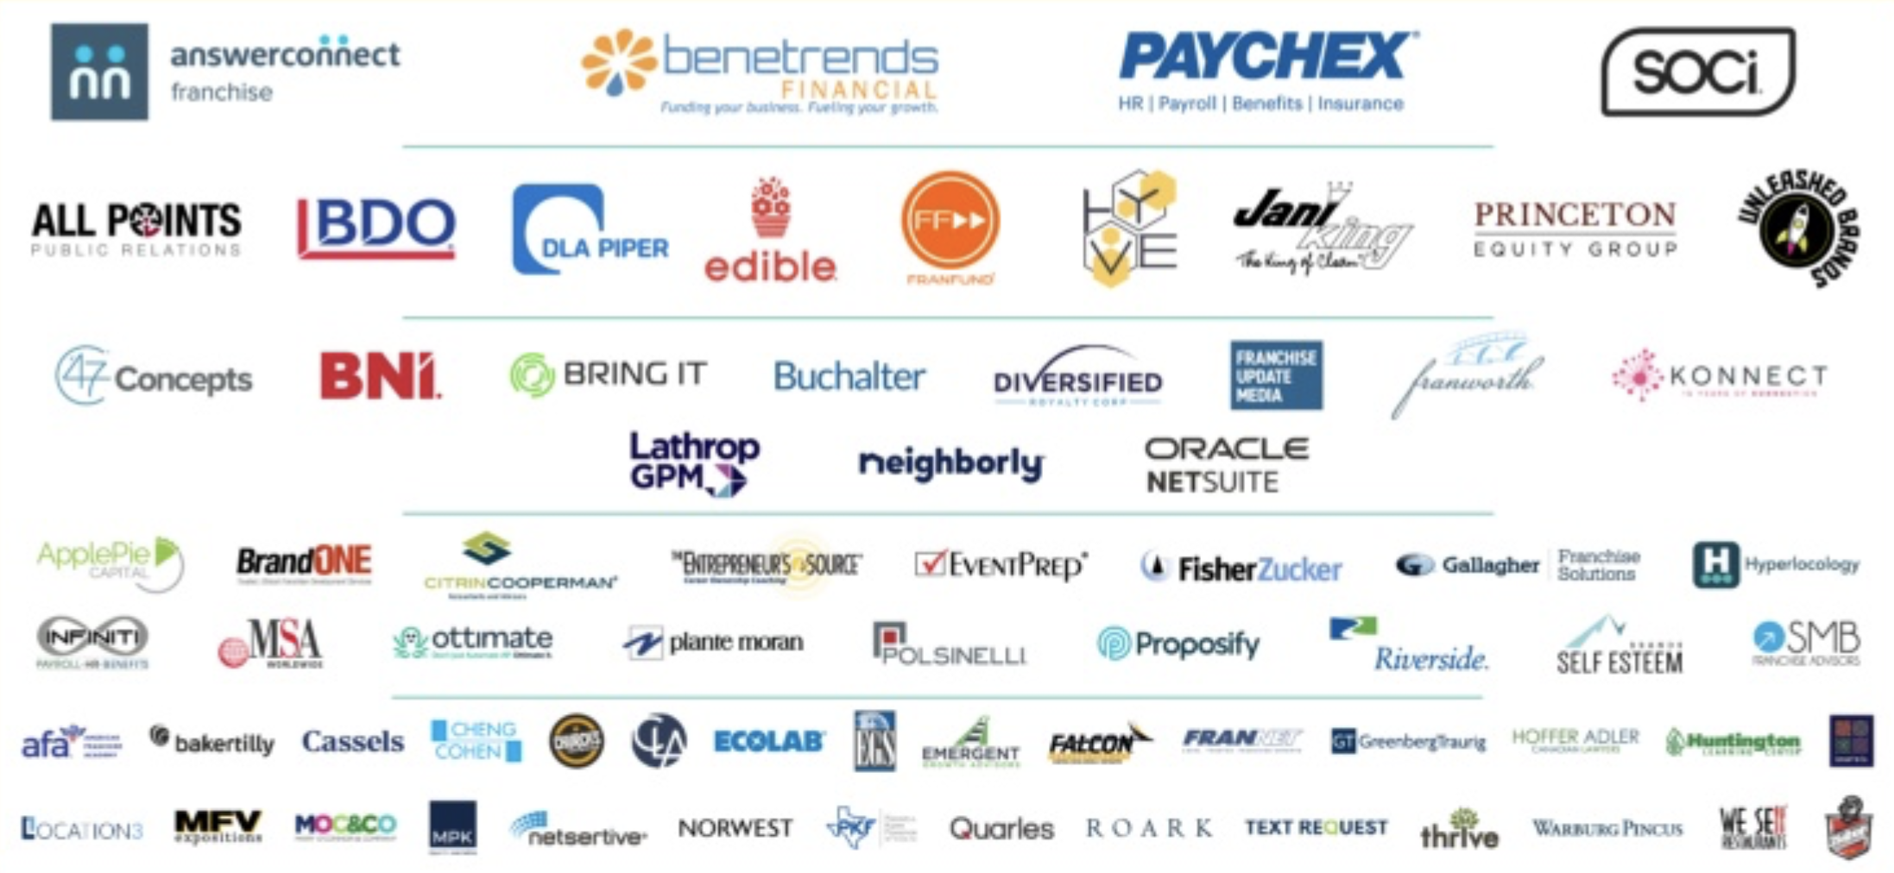
Thank You To Our Sponsors!

Slide 19
QUESTIONS?

